Slide 1
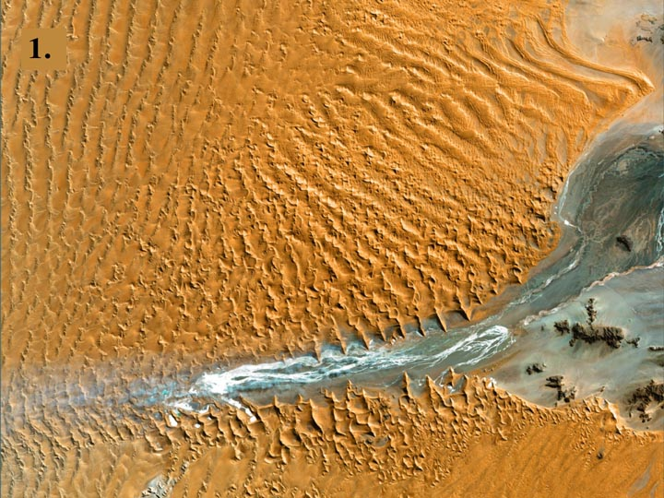
Notes:
#1 Namib Desert, Namibia
Landsat 7 image taken 8/12/2000
Namib-Naukluft National Park is an ecological preserve in Namibia's vast Namib Desert. Coastal winds create the tallest sand dunes in the world here, with some dunes reaching 980 feet (300 meters) in height.

Slide 2
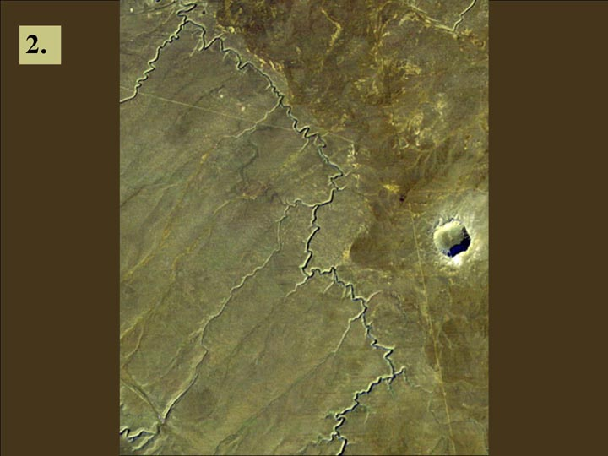
Notes:
#2 Barringer Crater
Barringer Crater, also known as “Meteor Crater,” is a 1,300-meter (0.8 mile) diameter, 174-meter (570-feet) deep hole in the flat-lying desert sandstones 30 kilometers (18.6 miles) west of Winslow, Arizona. Since the 1890s geologic studies here played a leading role in developing an understanding of impact processes on the Earth, the moon and elsewhere in the solar system. This view was acquired by the Landsat 4 satellite on December 14, 1982. It shows the crater much as a lunar crater might appear through a telescope. Morning sun illumination is from the southeast (lower right). The prominent gully meandering across the scene is known as Canyon Diablo. It drains northward toward the Little Colorado River and eventually to the Grand Canyon. The Interstate 40 highway crosses and nearly parallels the northern edge of the scene. The ejecta blanket around the crater appears somewhat lighter than the surrounding terrain, perhaps in part due to its altered mineralogic content. However, foot traffic at this interesting site may have scarred and lightened the terrain too. Also, the roughened surface here catches the sunlight on the southerly slopes and protects a highly reflective patchy snow cover in shaded northerly slopes, further lightening the terrain as viewed from space on this date.
Image Size: 16.9 km x 12.5 km
Colors: Bands 1 (blue), 2 (green) + 4 (near infrared), 3 (red) in blue, green, and red, respectively.
Note: This image was scanned from physical media.

Slide 3
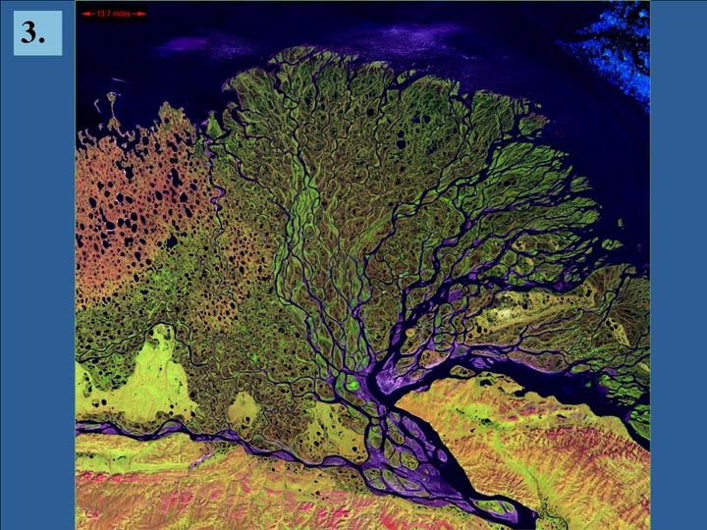
Notes:
#3 Lena Delta
Landsat 7 image taken 7/27/2000
The Lena River, some 2,800 miles (4,400 km) long, is one of the largest rivers in the world. The Lena Delta Reserve is the most extensive protected wilderness area in Russia. It is an important refuge and breeding grounds for many species of Siberian wildlife.

Slide 4
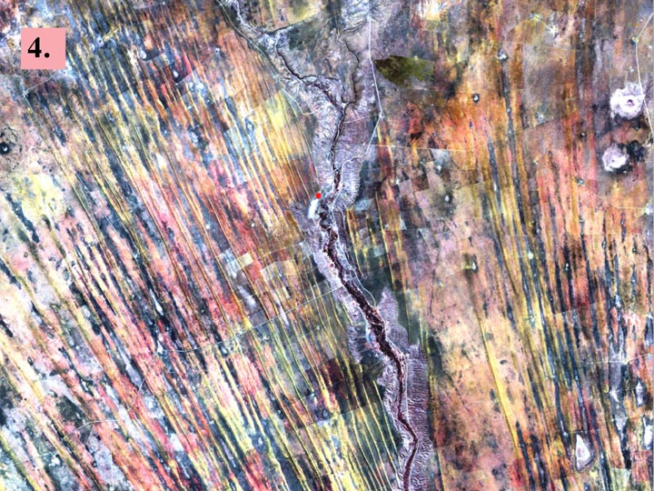
Notes:
#4 The Optimist, Kalahari Desert, Namibia
Landsat 7 image taken 8/14/2000
On the edge of the Kalahari Desert in Namibia, sand dunes are encroaching onto once-fertile lands in the north. Healthy vegetation appears red in this image; in the center, notice the lone red dot. It is the result of a center-pivot irrigation system, evidence that at least one optimistic farmer continues to work the fields despite the approaching sand.

Slide 5
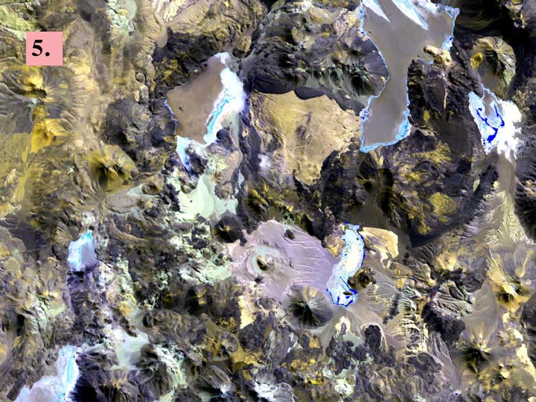
Notes:
#5 Chilean Volcanoes
Landsat 7 image taken 5/15/1999.
On the border between Chile and the Catamarca province of Argentina lies a vast field
of currently dormant volcanoes. Over time, these volcanoes have laid down a crust of
magma roughly 2 miles (3.5 km) thick. It is tinged with a patina of various colors that
can indicate both the age and mineral content of the original lava flows.

Slide 6
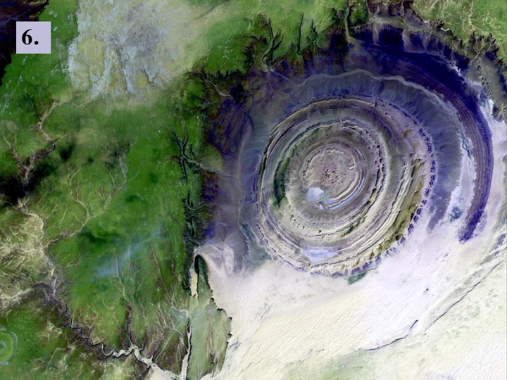
Notes:
#6 Richat Structure
Landsat 7 image taken 1/11/2001
The so-called Richat Structure is a geological formation in the Maur Adrar Desert in the African country of Mauritania. Although it resembles an impact crater, the Richat Structure formed when a volcanic dome hardened and gradually eroded, exposing the onion-like layers of rock.

Slide 7
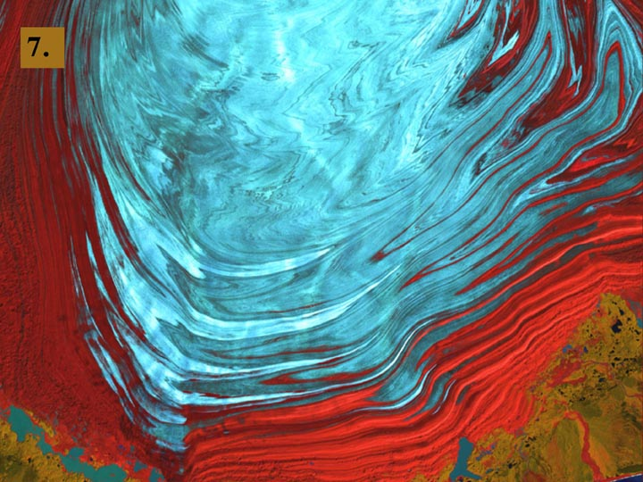
Notes:
#7 Malaspina Glacier
Landsat 7 image taken 8/31/2000
The tongue of the Malaspina Glacier, the largest glacier in Alaska, fills most of this image. The Malaspina lies west of Yakutat Bay and covers 1,500 sq. MI (3,880 sq. km).

Slide 8
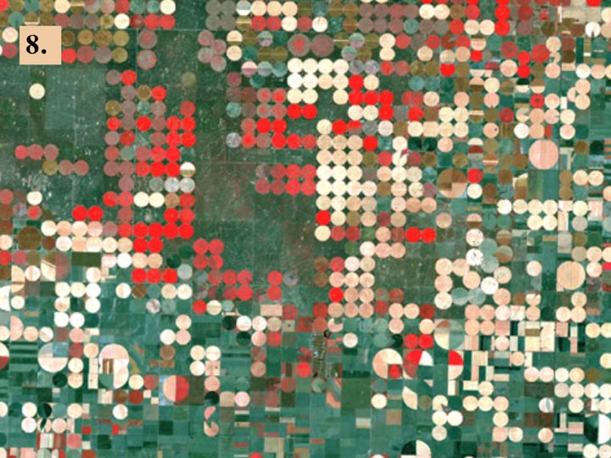
Notes:
#8 Garden City, Kansas
Landsat 7 image taken Sept. 25, 2000
Irrigation circles in agricultural landscape. Red indicates healthy vegetation.

Slide 9
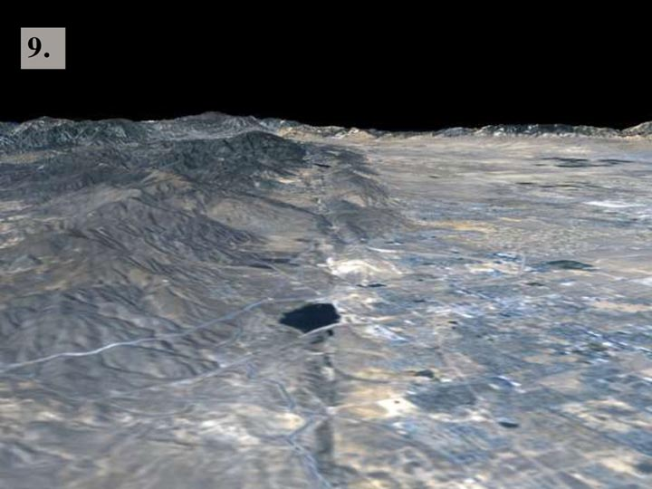
Notes:
#9 San Andreas Fault
The prominent linear feature straight down the center of this perspective view is the San Andreas Fault. This segment of the fault lies near the city of Palmdale, California (the flat area in the right half of the image)
about 60 kilometers (37 miles) north of Los Angeles. The fault is the active tectonic boundary between the North American plate on the right, and the Pacific plate on the left. Relative to each other, the Pacific plate is moving away from the viewer and the North American plate is moving toward the viewer along what geologists call a right lateral strike-slip fault. Two large mountain ranges are visible, the San Gabriel Mountains on the left and the Tehachapi Mountains in the upper right. The Lake Palmdale Reservoir, approximately 1.5 kilometers (0.9 miles) across, sits in the topographic depression created by past movement along the fault. Highway 14 is the prominent linear feature starting at the lower left edge of the image and continuing along the far side of the reservoir. The patterns of residential and agricultural development around Palmdale are seen in the Landsat Imagery in the right half of the image. SRTM topographic data will be used by geologists studying fault dynamics and landforms resulting from active tectonics.
This type of display adds the important dimension of elevation to the study of land use and environmental processes as observed in satellite images. The perspective view was created by draping a Landsat satellite image over an SRTM elevation model. Topography is exaggerated 1.5 times vertically. The Landsat image was provided by the United States Geological Survey's Earth Resources Observations Systems (EROS) Data Center, Sioux Falls, South Dakota.
Elevation data used in this image was acquired by the Shuttle Radar Topography Mission (SRTM) aboard the Space
Shuttle Endeavour, launched on February 11, 2000.

Slide 10
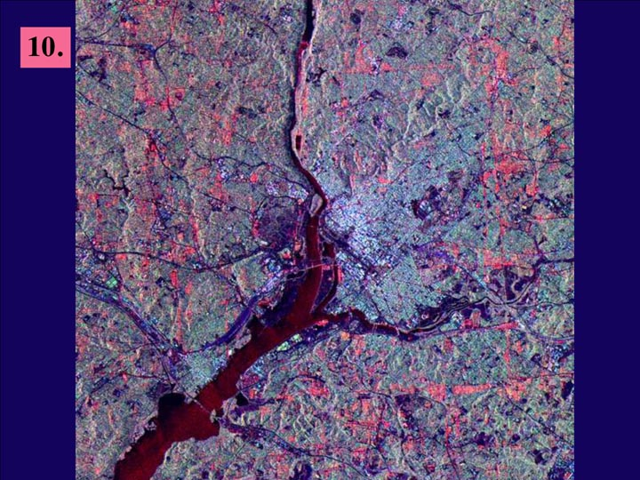
Notes:
#10 Washington, D.C.
Credit NASA JPL
The city of Washington, D.C., is shown is this space radar image. Images like these are useful tools for urban planners and managers, who use them to map and monitor land use patterns. Downtown Washington is the bright area between the Potomac (upper center to lower left) and Anacostia (middle right) rivers. The dark cross shape that is formed by the National Mall, Tidal Basin, the White House and Ellipse is seen in the center of the image. Arlington National Cemetery is the dark blue area on the Virginia (left) side of the Potomac River near the center of the image. The Pentagon is visible in bright white and red, south of the cemetery. Due to the alignment of the radar and the streets, the avenues that form the boundary between Washington and Maryland appear as bright red lines in the top, right and bottom parts of the image, parallel to the image borders.
This image is centered at 38.85 degrees north latitude, 77.05 degrees west longitude. North is toward the upper right. The area shown is approximately 29 km by 26 km (18 miles by 16 miles). Colors are assigned to different frequencies and polarizations of the radar as follows: Red is the L-band horizontally transmitted, horizontally received; green is the L-band horizontally transmitted, vertically received; blue is the C-band horizontally transmitted, vertically received. The image was acquired by the Spaceborne Imaging Radar-C/X-band Synthetic Aperture (SIR-C/X- SAR) imaging radar when it flew aboard the space shuttle Endeavour on April 18, 1994. SIR-C/X-SAR, a joint mission of the German, Italian and United States space agencies, is part of NASA's Mission to Planet Earth program.

Slide 11
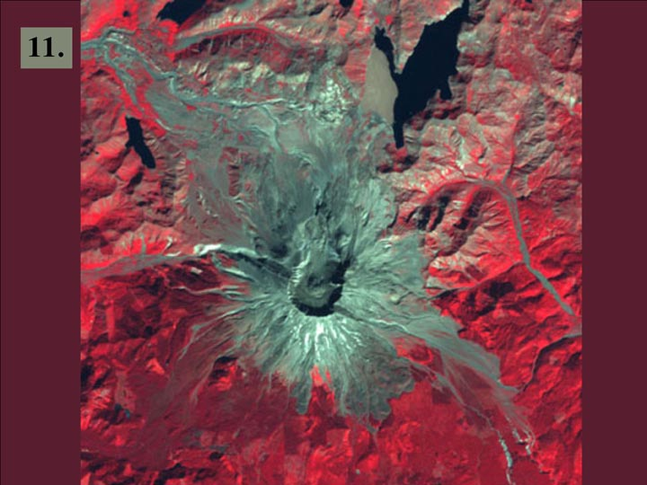
Notes:
#11 Mount Saint Helens
Landsat 7 image taken September 2000.
WRS-2 Path 46 Row 28, Bands 4,3,2.

Slide 12
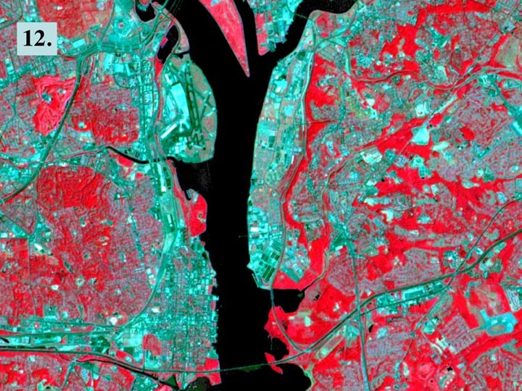
Notes:
#12 Washington, D.C
Landsat 7 image taken May 28, 1999.
Bands 4,3,2 merged with pan band for an effective pixel resolution of 15 meters.

